Slide 1
Ethical Hacking Intership Task 2
C N ADITYA SAI

Slide 2
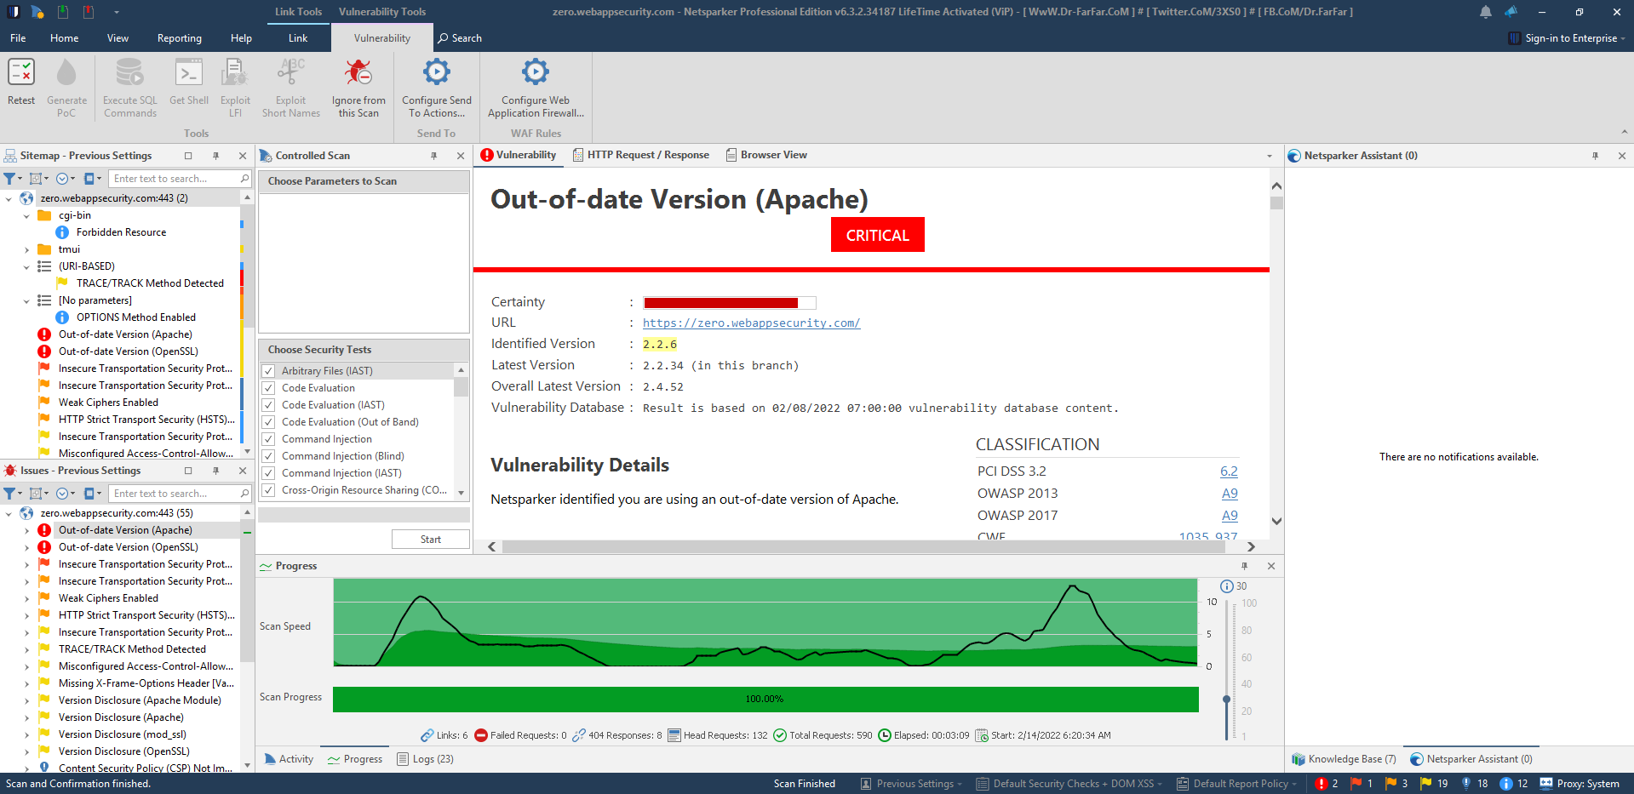
SCAN RESULTS

Slide 3
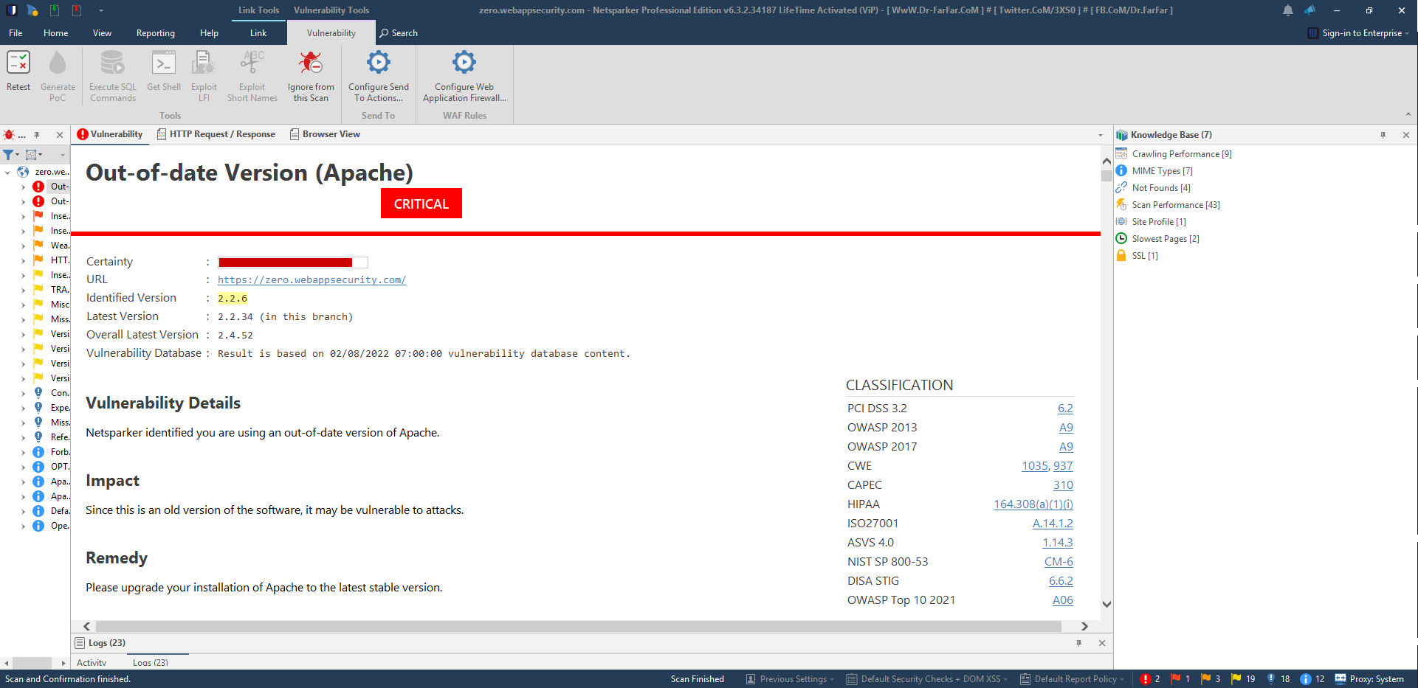
VULNERABILITY REPORT

Slide 4
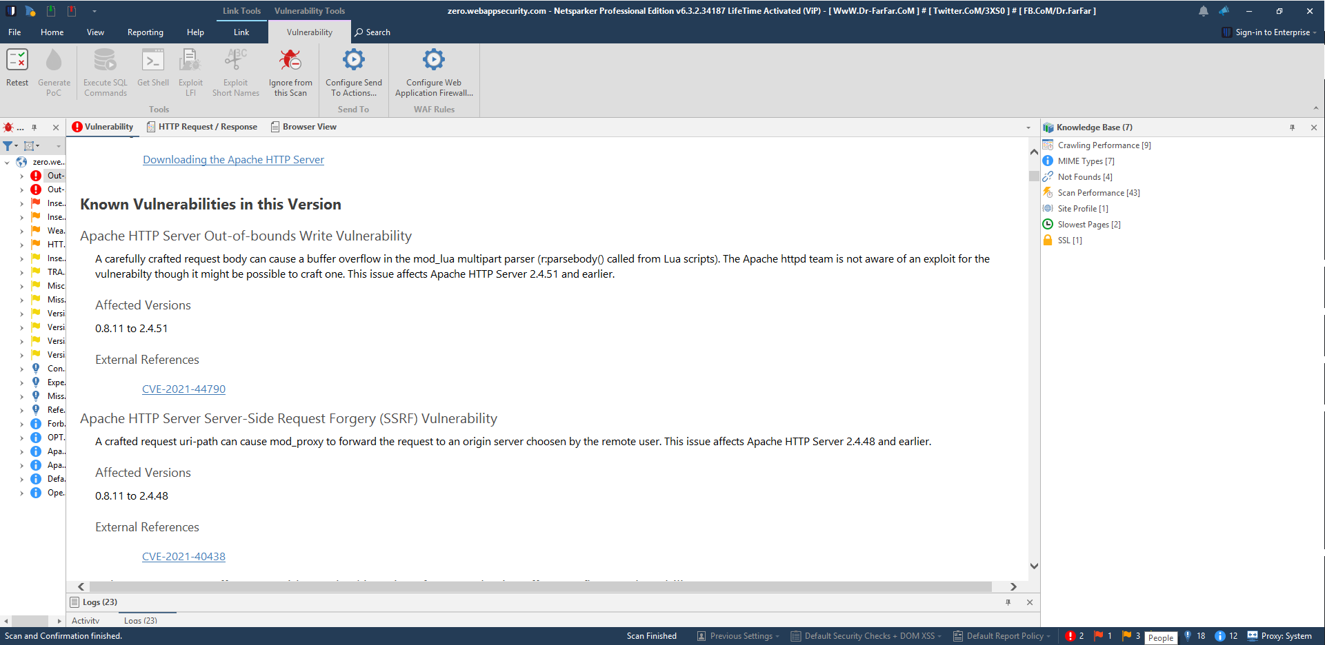
VULNERABILITY REPORT

Slide 5
REPORT
Report Title:
Out-of-date Version of Apache found on https://zero.webappsecurity.com/
Summary:
An Out-of-date version of Apache was found on the https://zero.webappsecurity.com/ which may be vulnerable to attacks. One of which is the Apache HTTP server out-of-bounds write vulnerability. It may cause a buffer overflow in the multipart parser. The program copies an input buffer to an output buffer without verifying that the size of the input buffer is less than the size of the ouput buffer, leading to a buffer overflow. Since it is the old version the exploit for the vulnerability can be found. It fails to check the buffer size of input. It may write beyond the end of a buffer when given malicious input. Any included modules can pass data to these functions.
Severity of the issue: Critical

Slide 6
REPORT
Vulnerable Code(Example):
Printf(“Enter a new first name.\n”);
Printf(“>>>”);
Rc = scanf(“%s”,records[idx].first_name);
If(rc!=1){
Printf(“Invalid input.\n”);
Exit(1);
}
Steps to Reproduce:
Prepare a javascript/python payload that we want to inject into the buffer.
Inject this payload into the buffer after the actual input.

Slide 7
REPORT
Impact:
With user interaction, an attacker could execute the payload when a victim enters the site.
Perform any action in the identified endpoint.
View any information that the user is able to view.
Modify any information that the user is able to modify.

